Slide 1

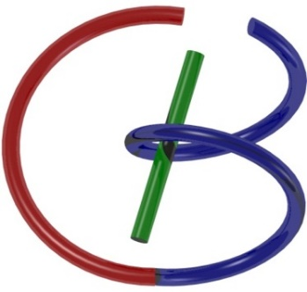
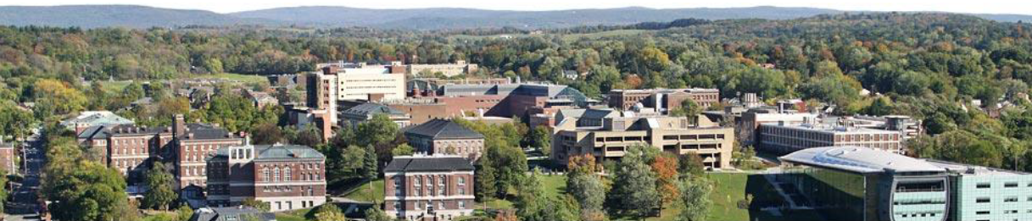
K-Space
Ge Wang
AI-based X-ray Imaging System (AXIS) Lab
Rensselaer Polytechnic Institute, Troy, New York, USA
October 19, 2021

Slide 2
MI Schedule for F21
Tue | Topic | Fri | Topic
08/31 | Introduction | 09/03 | Neuron, Network & Backpropagation
09/07 | No Class | 09/10 | Hands-on 1: Python, Colab, & TensorF
09/14 | Architectures & Training | 09/19 | Hands-on 2: MNIST Classification
09/21 | Image Quality I | 09/24 | CT Physics
09/28 | CT Reconstruction | 10/01 | Deep CT Reconstruction
10/05 | Hands-on 3: CT Networks | 10/08 | More CT Contents
10/12 | MRI Physics | 10/15 | Spin-Echo
10/19 | K-Space Theorem | 10/22 | More MRI Contents
10/26 | Mid Exam | 10/29 | Deep MRI Reconstruction
11/02 | Hands-on 4: MRI Networks | 11/05 | Nuclear Physics
11/09 | Nuclear Imaging | 11/12 | US Imaging
11/16 | Optical Imaging | 11/19 | Multimodality Imaging
11/23 | Hands-on 5: Image Conversion | 11/26 | Thanksgiving
11/30 | Image Quality II | 12/03 | Stability, Interpretability, & Others
12/07 | Overview | 12/10 | Final Exam
Office Hour: Teaching Day 5-6pm: https://rensselaer.webex.com/meet/wangg6

Slide 3
Outline
Magnetization Vector
Bloch Equation, T1 & T2
Spin Echo

Slide 4
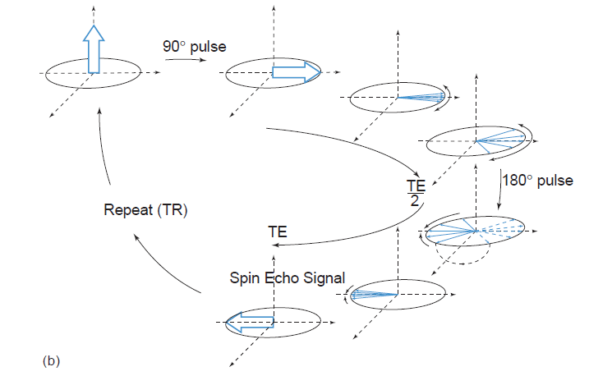
Spin-Echo Idea

Slide 5

Controlled Running
Starting Point
Different Mileage
New Alignment
Direction Change

Slide 6
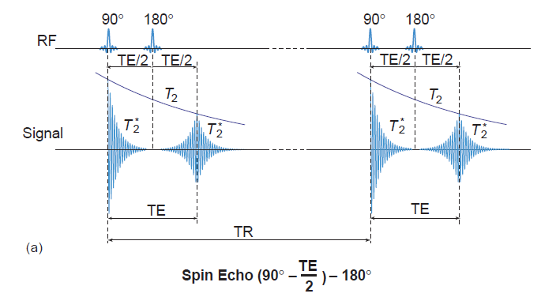
Spin-Echo Signal

Slide 7
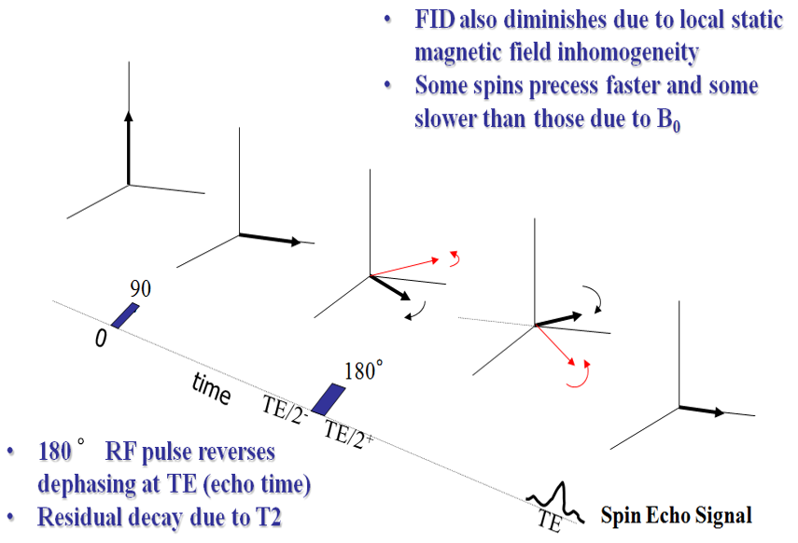
Spin-Echo Variant

Slide 8
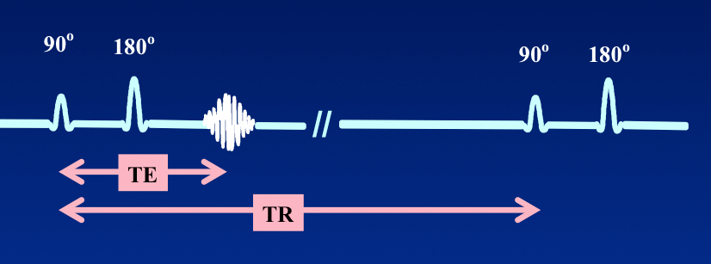
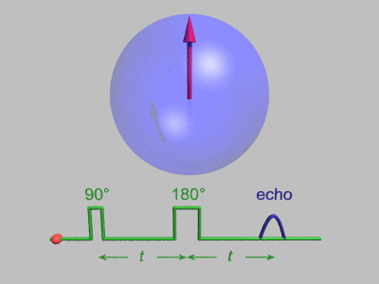
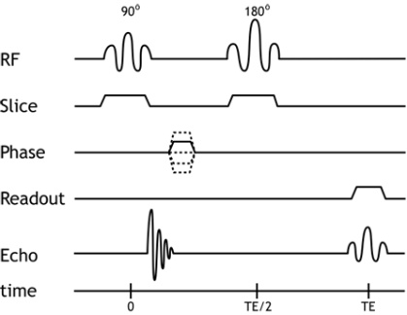

TE & TR Parameters
To explain these soon
As your homework, please explain this slide in your words

Slide 9
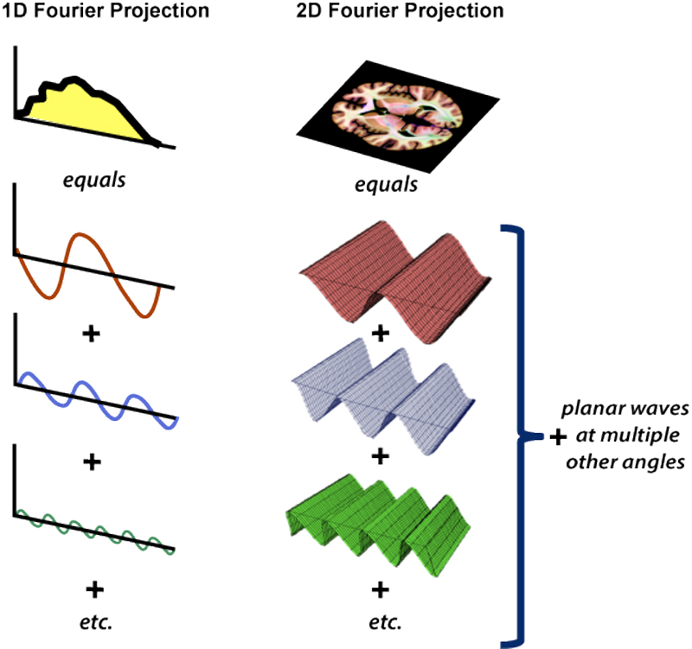
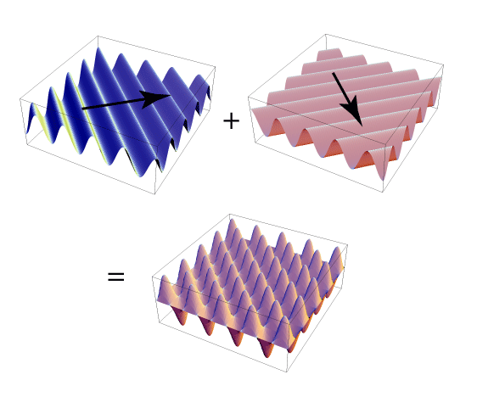
Fourier Analysis: Visualization
http://mri-q.com/what-are-2d---3d-fts.html

Slide 10
Fourier Analysis: Formulation

Slide 11
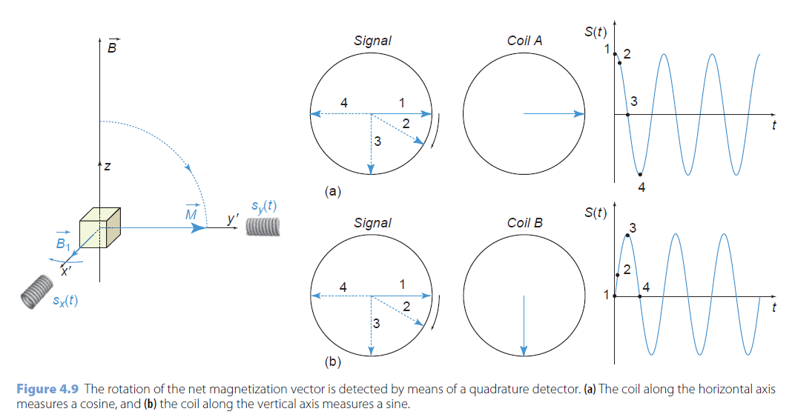
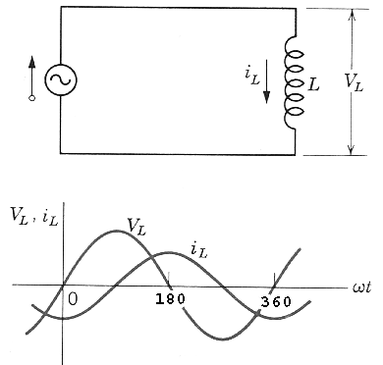
MR Signal Model

Slide 12
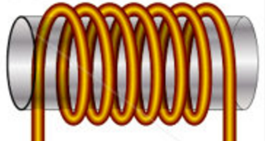
Signal Model for a Whole Object
Rotating Transverse Component of M Induces a Current in Quadrature Coils
In the Rotating Frame:
Repeated after TR:
Total Signal:
z
s_{y}(t)
M
y’
x’
s_{x}(t)
Determined by Proton Density ρ, T₁, & T₂ (Biological)
as well as B₀, TR, TE, & t (Technical)

Slide 13
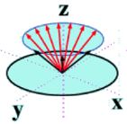
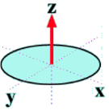
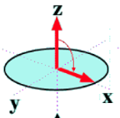
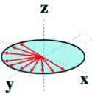
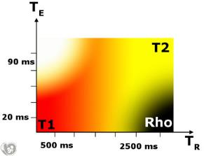
ρ-, T₁- & T₂-weighting Illustrated
Key Points to Understand:
Long TR: M Fully Recovered so No T₁ Effect
Short TE: M_{xy} Has Little Time to De-phase so No T₂ Effect
Short TR
Long TR
Short TE
Long TE
Short TR (Short TE): T1-weighted
Long TE (Long TR): T2-weighted
Long TR & Short TE: ρ-weighted

Slide 14

Images Weighted Differently
ρ Weighted T2 Weighted T1 Weighted
Tissue Type | T1(s) | T2(s)
Grey Matter | 1.0 | 0.10
White Matter | 0.7 | 0.08
Cerebrospinal Fluid (CSF) | 2.0 | 0.25
Blood | 1.2 | 0.25
Water | 4.7 | 3.50

Slide 15
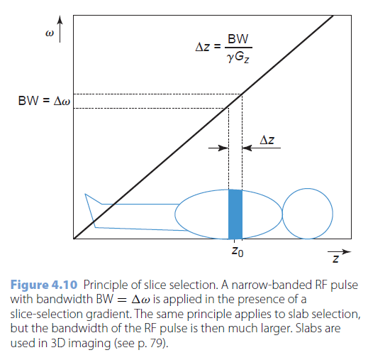
Slice Selection
RF pulse at ω(z) = γ(B₀+G_{z}z) has BW = Δω around γ(B₀ + G_{z}z₀)
SSP = rectangular means RF pulse = sinc, practically impossible
Very thin slices cannot be selected
G_{z} is limited (50-80mT/m)
Small BW requires long pulse
Thin slice -> few spins -> less SNR
Large B₀ increases SNR
B₀ is also limited (7T)
Δz_{min}: 2mm (1.5T); 1mm (3T)

Slide 16
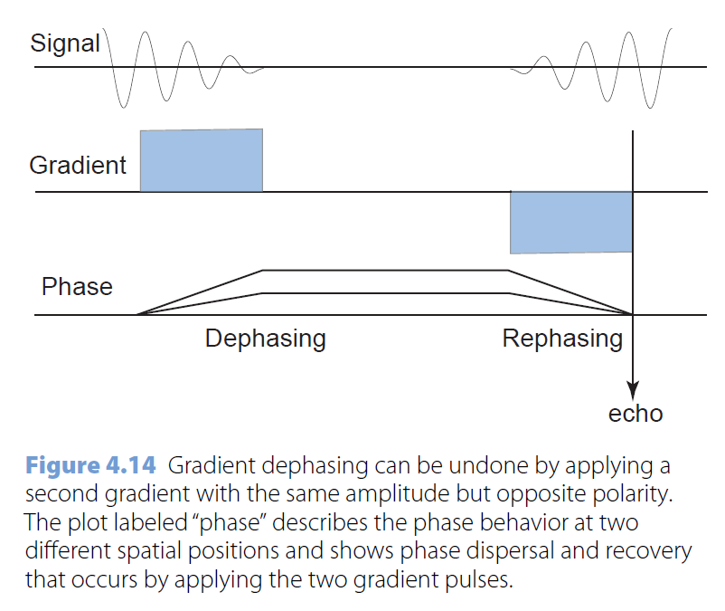
Gradient Echo
Gradient Echo (GE)
Gradient with Opposite Polarity

Slide 17
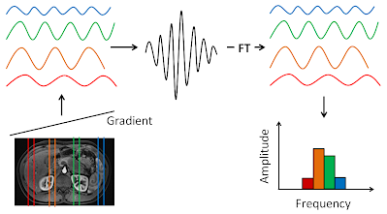
Frequency Encoding

Slide 18
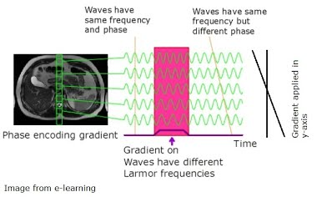
Phase Encoding

Slide 19
Position encoding: the k-theorem
(after the slice selection gradient G_{z} and the RF pulse)
Example : G_{x} = constant linear gradient in x-direction
General case : G(t) = (G_{x}(t), G_{y}(t), G_{z}(t))
Example: G_{x} at t = TE -> ω(x) = γ (B₀ + G_{x}.x) for t TE in rotating frame
integration over the xy-plane :
ρ(x,y) = net magnetization density in (x,y) ~ spin or proton density in (x,y)
G_{x}
ω(x)
TE
t

Slide 20
Defining and è for t TE ω(x) = γ G_{x} . x
2πk_{x} = γ G_{x} . (t – TE)
k_{y}
G_{x}
k_{x}
TE
t
s(t)

Slide 21
General case: G(t)
è
define
è
Fourier transform:
if and time-independent
then k-theorem
short measurement interval
(read out period) -> t = t*
no motion
(breathing, blood flow, ...)

Slide 22
Signal Model with Gradients
Signal Model for a Whole Object in the lab frame
Spin-Echo Signal Model for a Whole Object with a 90˚ Pulse in the Rotating Frame
Trajectory in the k-space
Signal Model with Gradient Fields

Slide 23
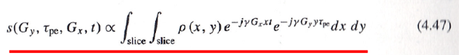
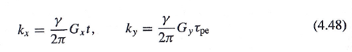
Phase/Frequency Encoding (τ – prep / t - take)
Signal model used in the undergraduate lecture:
γG_{x} t/2π, γ G_{y} τ_{pe}/2π
γG_{x} t/2π, γ G_{y} t/2π
γG_{x} τ_{pe_x}/2π, γ G_{y} τ_{pe_y}/2π
γG_{x} τ_{pe_x}/2π, γ G_{y} t/2π

Slide 24
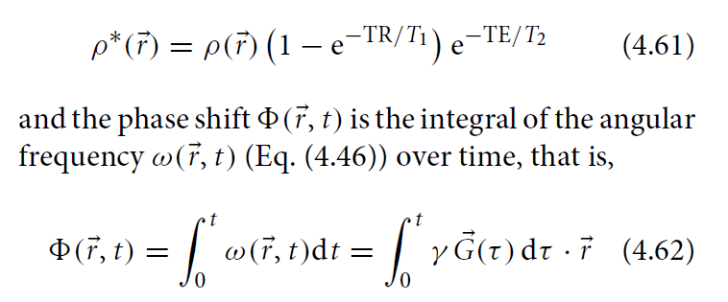
Initial Phase
Over a time interval [0, t], the “phase factor” is given by the above equation (note that the phase increment rate is an inner product of the gradient vector G and the positional vector r).
If you don’t measure over [t, t+Δt] you accumulate the phase factor.
If you measure over [t, t+Δt] you obtain a single k sample at the location determined by the current phase factor.

Slide 25
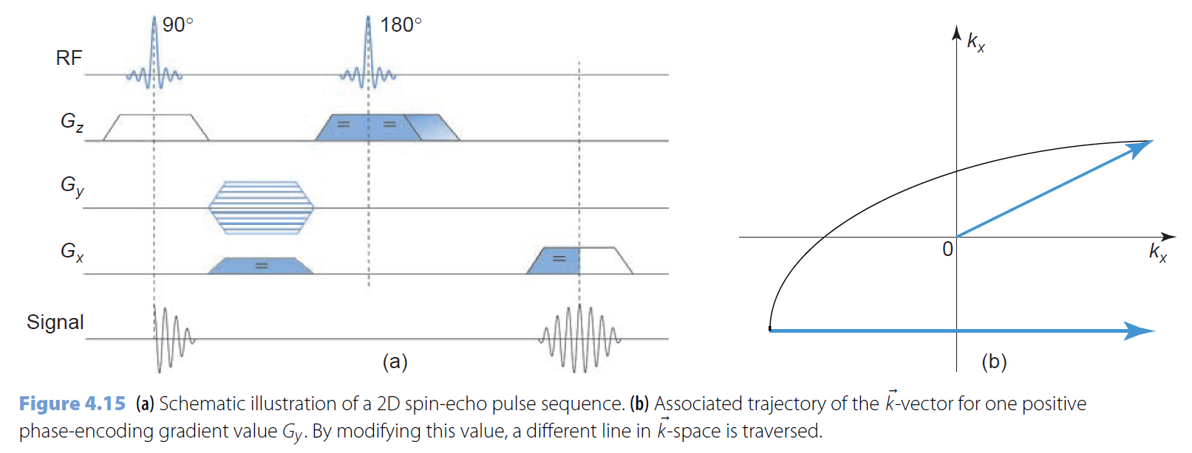
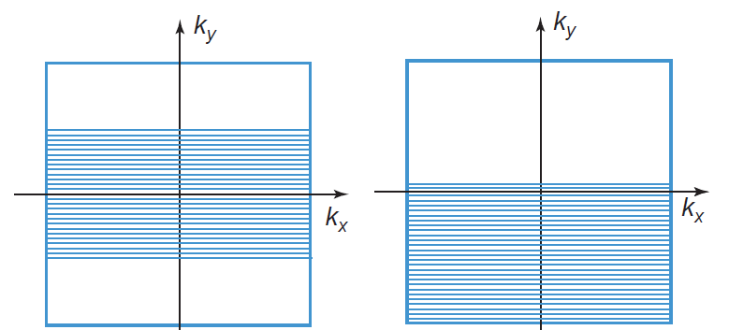
Trajectory in the k-space

Slide 26
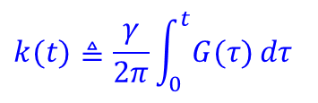
Summary: K-Theorem
$$k(t)≜\frac{γ}{2π}\int_{0}^{t}{G(τ)}​dτ$$
Quick Readout t = t*
Little Motion r(t)=r(t*)

Slide 27
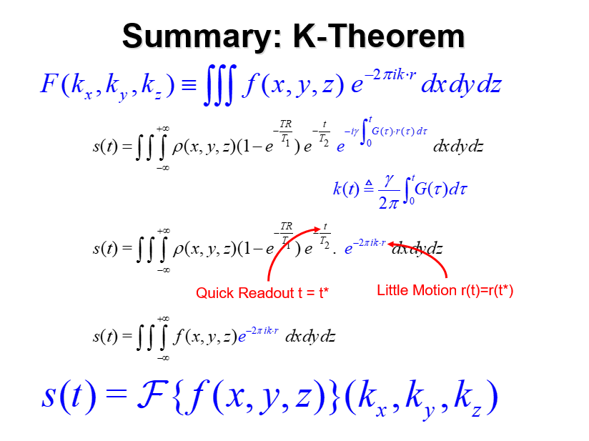
Summary Copy (For Correct Typesetting)

Slide 28
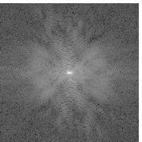
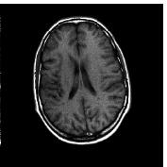
MRI Data & Image
k_{y}
y
s(t) = F(k_{x},k_{y})
f(x,y)
k_{x}
x
k-space
Modulus of s(t) IFT of F(k_{x}, k_{y})

Slide 29
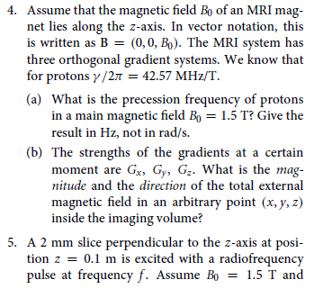
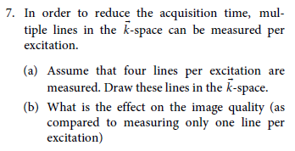
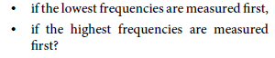
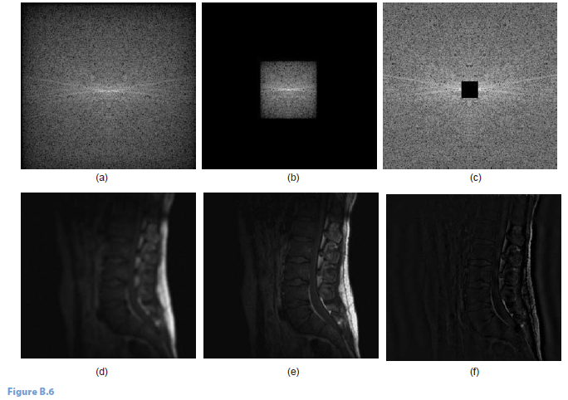
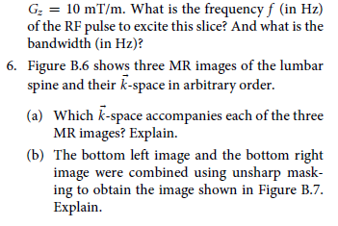
Homework

